Slide 1
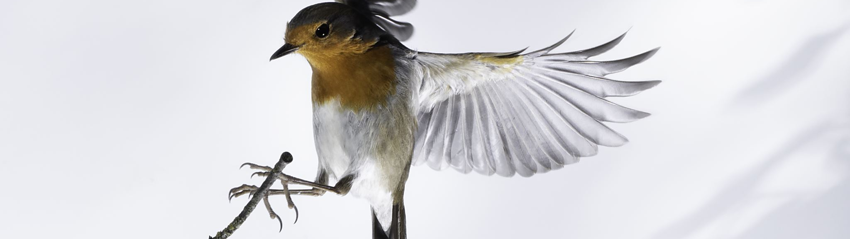
Classifying Bird Species With Image Recognition
Brendon Bottle
And
Sean McManus

Slide 2
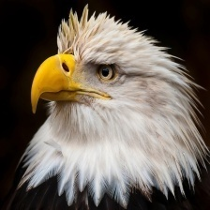
Problem Description
Project goal: Classify images of birds into the correct species
Potential use case: Bird population counts
Method: A convolutional neural network optimized for image classification
Notes:
For our project, we were working to build an image classifier to classify the species of a bird based on its picture. An example of a use case for this would be evaluating population numbers for birds, particular in remote areas where you might use a drone to collect images and then evaluate if an endangered species had recovered its population numbers.
Since we were building an image classifier, we focused on a convolutional neural network to achieve our goal.

Slide 3
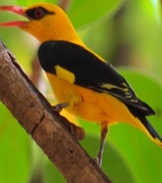
Dataset
The full dataset contains 525 unique species of birds with 100-200 images per species
The training data was reduced to 20 species with 100 images per species
The validation and test sets contain 5 image for each type of bird
Each image contains only one bird, which comprises at least 50% of the pixels
Notes:
The dataset we used had 100-200 images per species of 525 unique species. In order to make the scope of the problem more manageable for this project, we reduced our total number of species to 20.
The data was already divided into training, validation, and test sets. Each image was precleaned so that there was only one bird per image and the bird comprised at least 50% of the pixels.
To maintain class balance, we only the first 100 images for each bird in our training set. The validation and test sets contained 5 images each per species.

Slide 4
Base Model Performance
Model Used | EfficeintNetB0
Weights Applied | ImageNet
Epochs Run | 5
Best Validation Accuracy | 100%
Best Validation Loss | 0.0015
Notes:
To evaluate how well a complex model would perform on our dataset, we used a pre-trained EfficentNetB0 model with ImageNet weights. After only 5 epochs the model was already predicting with 100% accuracy on the validation data, indicating this was a problem that would lend itself well to a being solved by neural nets.

Slide 5
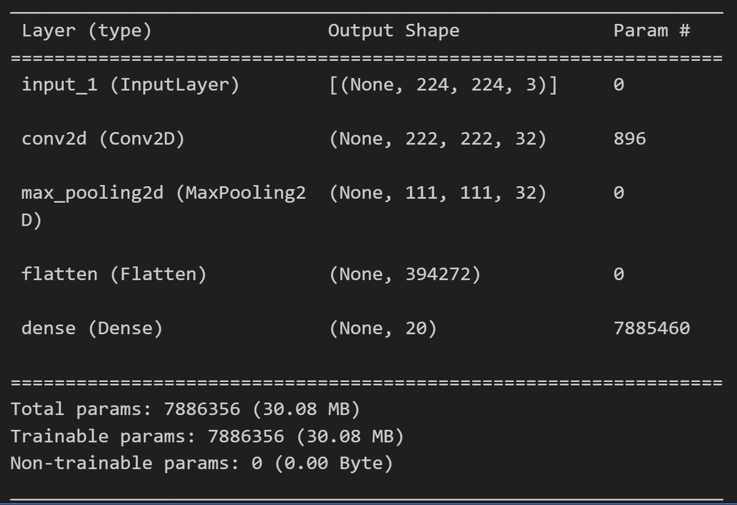
Simple Model Performance
Epochs Run | 21
Validation Accuracy | 81%
Validation Loss | 0.8571
Notes:
As a starting point, we trained a very simple model with 1 convolutional layer, a MaxPooling layer, and a softmax layer.
Using early stopping, we achieved a validation accuracy of 81% and a loss of .8571 after 21 epochs.

Slide 6
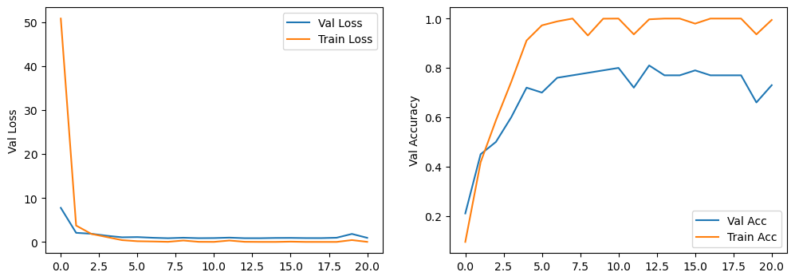
Simple Model Evaluation – Fit of Model
Notes:
Looking at the fit of our model, while the training accuracy was bouncing around a bit, it was showing a tendency to overfitting after only a few epochs.

Slide 7
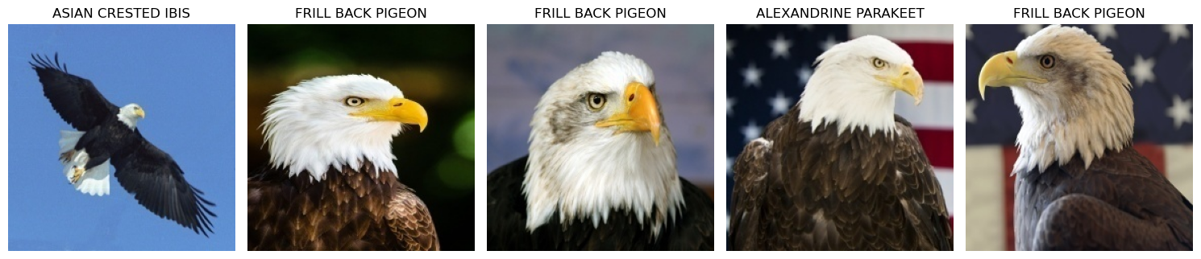
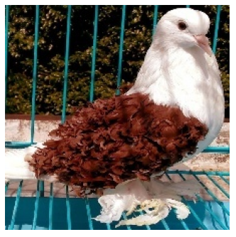
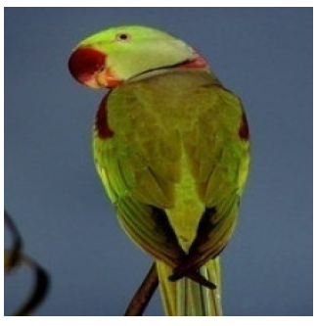
Simple Model Evaluation – Misclassified Birds
Notes:
Due to the randomization of keras, there were slight differences in which birds were classified as which species on our two machines, however there were some consistent themes across that helped us evaluate what the model was learning.
One of these commonalities was that bald eagles were completely misclassified in the simple model, and Blue Herons were also very poorly classified.

Slide 8
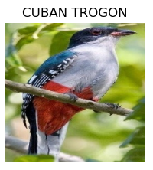
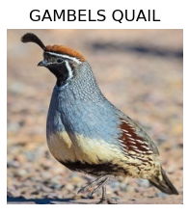
Simple Model Evaluation – Correct Birds
Good Classification
Large, colorful patches
Unique characteristics (Quail’s Crest)
Full bird bodies
Bad Classification
Muted Colors
Close Cropped Images
Notes:
We also found that in all instances the gambles quail and the Cuban trogon were 100% correctly classified. This indicated the model was only picking out highly distinctive features. Very bright patches of color on the trogon and the plume and the quail. They also tended to be full body images rather than just a head. The images that were poorly classified appeared to be of birds with very muted colors and very close up, cropped images.

Slide 9
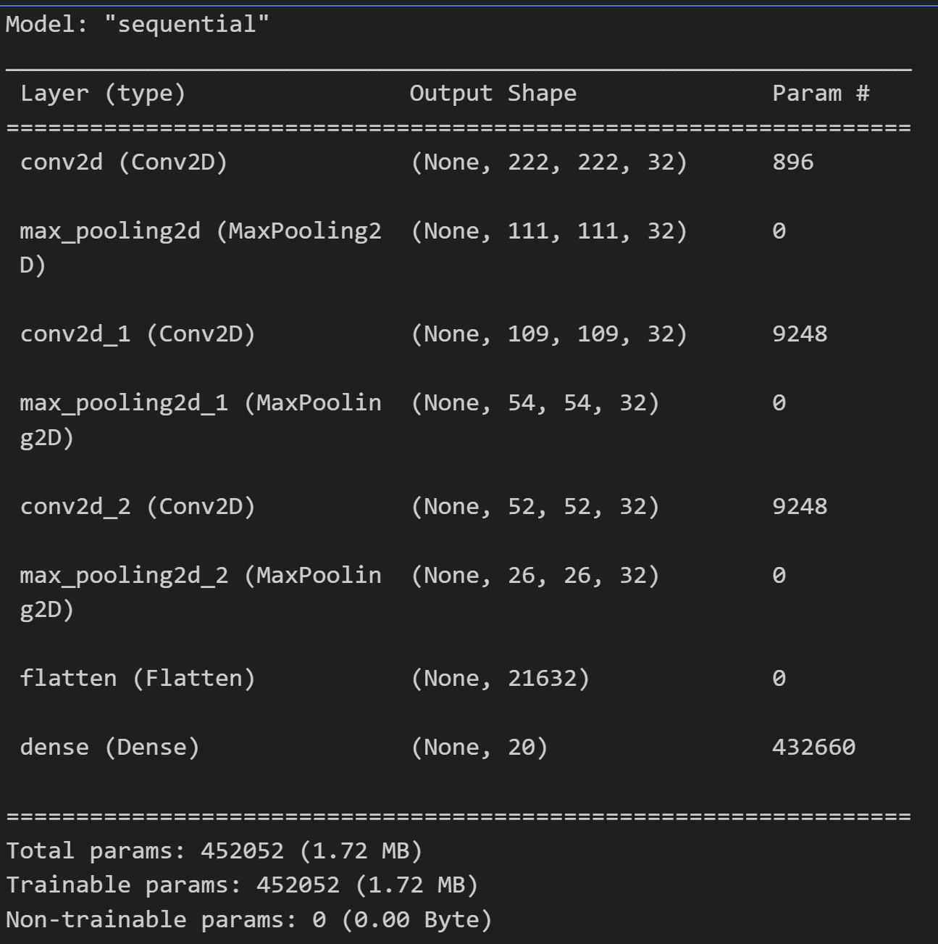
Proposed Improvements
Increase Model Complexity
Add more CNN layers to differentiate features more
Included MaxPooling to support model invariance
Notes:
Based on our evaluation, it was apparent that the model was only learning very shallow features and making its predictions on those, leading to limited predictive power and overfitting. This worked very well for our birds that were distinctive but meant that the model wasn’t learning anything about the less distinctive birds.
As a first step to helping our model, we increased the complexity to get the model to recognize more of the less distinctive features. We added two CNN layers to help differentiate the features more and followed each of them with MaxPooling to build model invariance.

Slide 10
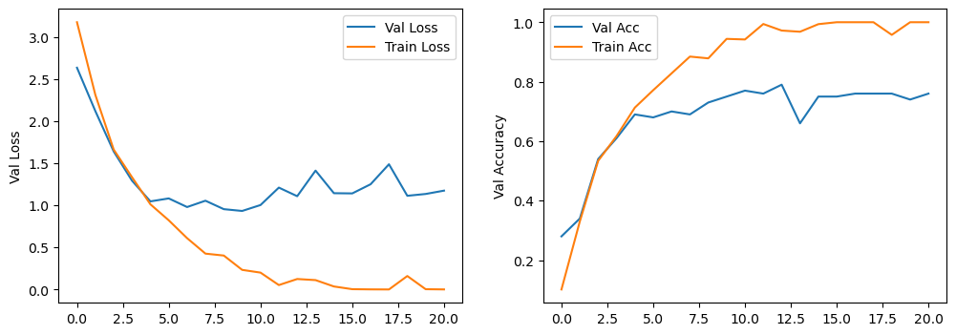
Complex Model Evaluation
Improvements
No species 100% misclassified
Mode birds 100% correctly classified
Challenges
Drop in accuracy/increase in loss
Model still overfitting after only a few epochs
Validating Assumptions
Distinctive features still taking precedent
Grayscale model resulted in significant drop in accuracy
Notes:
The additional complexity had a few impacts, some improvements and some challenges. The additional complexity did allow the model to correctly predict 1 of the bald eagle pictures, and it was able to 100% correctly classify more birds than the dimple model. However, the birds in the middle had mixed results in whether they were classified better, worse, or the same resulting in a decrease in overall accuracy and an increase in loss. Our model was also still overfitting after a few epochs.
Again, the birds that were doing well tended to be colorful or distinctive (both quails were now being classified correctly). Based on these birds, our assumption was that color was one of the most impactful features that our model was learning. To test this, we ran the complex model again, but this time trained it on grayscale images. In this case our accuracy plummeted and many of the birds that had been correctly classified were being misclassified. However, quails were still doing very well. This helped validate our assumption that the model was overlearning this distinctive features and making it less flexible for the other birds.

Slide 11
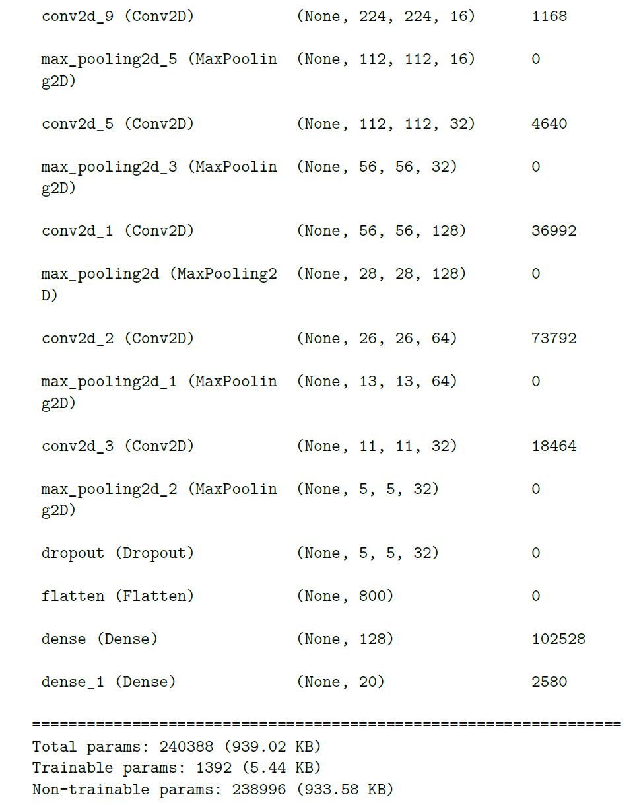
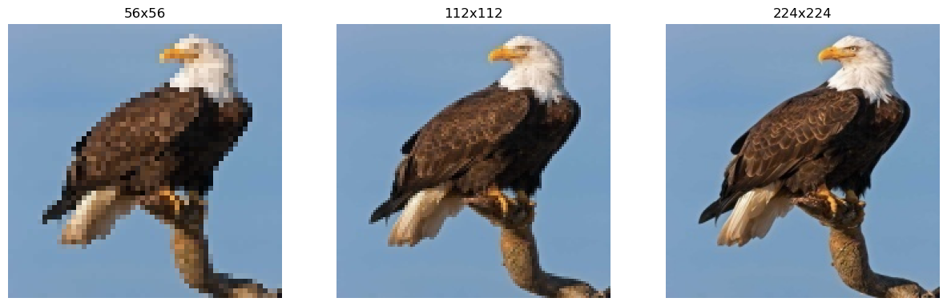
Progressive Resizing
Progressively resize images to prevent model from focusing on noise
Increase from 56x56 to 224x224
Lock weights in later layers to prevent it from retroactively learning noise
More filters in alter layers
Notes:
Because our model was overfitting and apparently overlearning these more prominent features, but the complexity was helping diversify the results, we wanted to find a different way to help the model generalize a bit more.
To do this, we used a method called progressive resizing. This method works by downscaling the image to “fuzz” the details and eliminate noise. The model is then progressively built on images of higher quality with the weights of the previous layer being locked. This helps to ensure that the model doesn’t pick up too much noise from the higher quality pictures.
For our model we used our complex model on 56x56 images. We also increased the nodes in the three CNN layers to 128, 64, and 32 respectively in order to draw more information from these lower quality pictures. We then introduced a dropout layer to combat the overfitting from our previous model.
We then trained two more CNN layers on 112x112 and 224x224 (the original size), decreasing the filters as the quality of the image increased to focus on the model on the smaller details.
Because we ontroduced the dropout layer, we removed early stopping and let each model run for 100 epochs.

Slide 12
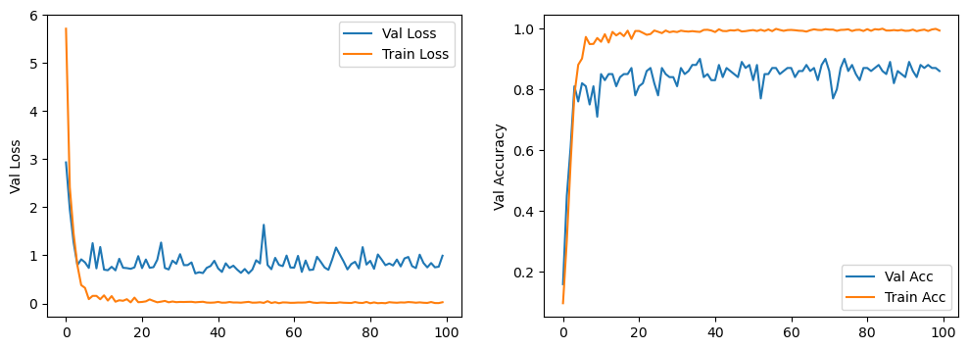
Progressive Model Evaluation
 | 56x56 | 112x112 | 224x224
Accuracy | 88.99% | 89.99% | 88.99%
Loss | 0.8063 | 0.6321 | 0.7629
Overfitting improved on this version
56x56 model gave a significant boost in accuracy
112x112 improved Bald Eagle predictions
224x224 dropped accuracy and lost Bald Eagle improvements
Notes:
This model saw an immediate, and significant, boost in accuracy when dropping images to 56x56. This validated our assumption that the model was learning less generalizable features from the details. When going to 112x112 we saw both an improvement in accuracy, loss, and in our predicitons for Bald Eagles. However, going back up to 224, while the loss was slightly better than 56x56, caused our accuracy

Slide 13
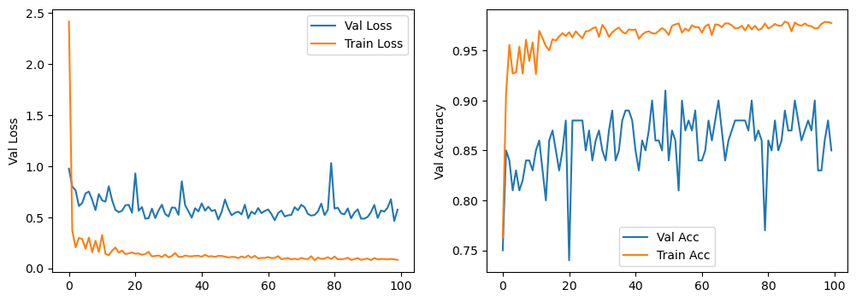
Additional Images
224x224 image quality not learning correct features for poorly classified birds
Added additional images to diversify poorly classified species
Validation Accuracy | 91%
Validation Loss | 0.5178

Slide 14
Conclusion

